Slide 1
A Hierarchical Decision Engine for Computer Aided Lung Nodule Detection from CT Images
Omer M Soysal, Ph.D.

Slide 2

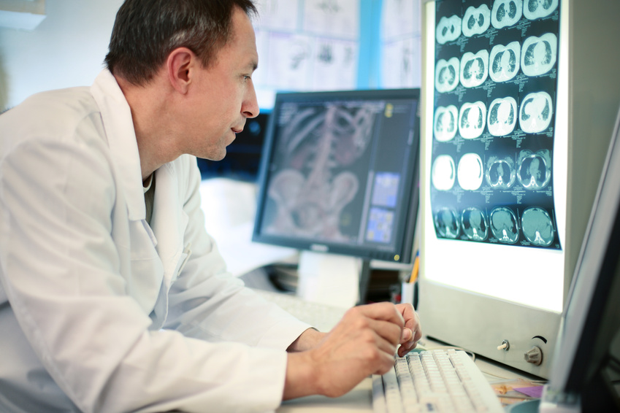
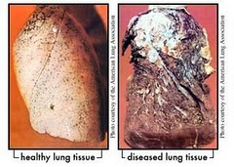
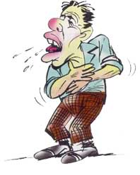


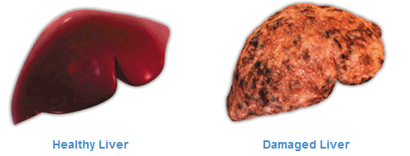
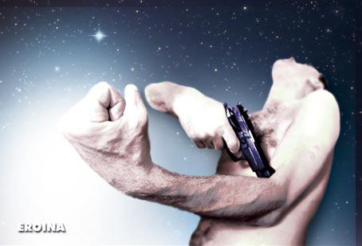
Once upon a time
How can a MACHINE help the doctor?

Slide 3
Motivation
32% men & 25% women of cancer deaths
150, 000 deaths/year
Need for a Computer Aided Detection System
Early detection
Overlook
Too many images to go over
data explosion
Fatigue
Second opinion
What do you think?

Slide 4
A Computer Aided Detection System
Nodule
CAD SYSTEM
Non-Nodule

Slide 5

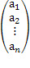
A Computer Aided Detection System
Preprocessing
Extraction of ROI
Assessment
Archive
Result
Candidate Search
Rules
Detection & Diagnosis
Feature Extraction

Slide 6
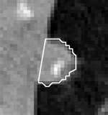

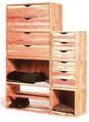
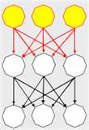

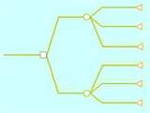
A comprehensive CAD Framework
integrated system
combine higher spatial dimensional analysis with global and local feature level analysis
demanding less computational time
high performance detection accuracy
be able to mimic human intelligence
flexibility that allows
different classification approaches
modification of its units should not require redesigning entire system

Slide 7
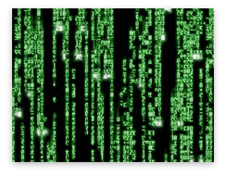

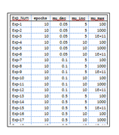
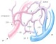
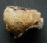
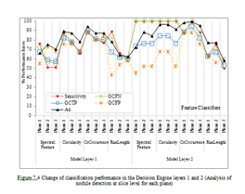
The Framework Proposed
Feature Extraction
Preprocessing
Image Data Retrieval
Feature Set Preparation
Results
Decision Engine
Experiment Groups
Detections
Testing and Analysis

Slide 8
…The Framework Proposed

Slide 9
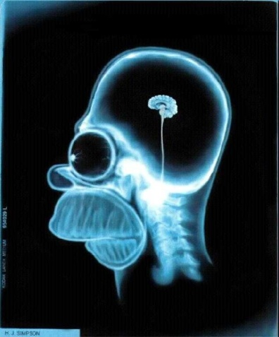
The story starts being sick

Slide 10
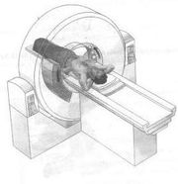
CT Imaging System
The X-ray energy is produced and directed by a beam in the form of rays.

Slide 11
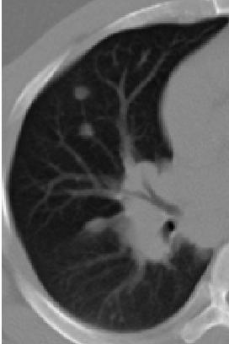
A Sample CT Image
-780 | -727 | -657 | -635 | -651 | -687 | -753 | -801 | -802 | -780 | -800
-820 | -781 | -708 | -651 | -639 | -669 | -704 | -745 | -764 | -783. | -808
-825 | -812 | -765 | -683 | -636 | -628 | -658 | -715 | -761 | -792 | -831
-829 | -822 | -797 | -735 | -659 | -622 | -630 | -682 | -766 | -802 | -806
-819 | -810 | -791 | -785 | -734 | -652 | -613 | -652 | -739 | -800 | -824
-764 | -767 | -753 | -764 | -746 | -673 | -618 | -616 | -655 | -706 | -771
-641 | -632 | -631 | -659 | -680 | -645 | -561 | -506 | -528 | -595 | -674
-540 | -561 | -564 | -597 | -626 | -609 | -520 | -452 | -440 | -503 | -591
-507 | -562 | -591 | -595 | -600 | -607 | -555 | -499 | -464 | -475 | -511
-553 | -593 | -602 | -612 | -612 | -613 | -592 | -552 | -499 | -473 | -481
digital representation of a physical object

Slide 12
The Goal is
-651 | -687 | -753 | -801
-639 | -669 | -704 | -745
-636 | -628 | -658 | -715
-659 | -622 | -630 | -682
-734 | -652 | -613 | -652
Replace a radiologist by the machine
Give a second opinion and relieve the load

Slide 13
Challenges & Comparisons
Computational resource allocation
2D vs. 3D
Global vs. local
Discriminative power
Multi-perspective
2D vs. 3D
Global vs. local
Curse of dimensionality
Overlapping gray levels
Human intelligence vs. Machine intelligence for pattern recognition
Powerful pattern recognition
Limited eye vision
8 bit ≡ 256 contrast level

Slide 14
How does the Machine accomplish the detection?
IMAGE CONTENT
MACHINE INTELLIGENCE

Slide 15
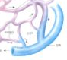

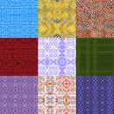
Image & Content
An image is an abstraction of a real object.
Image is defined as “a two-dimensional representation of a scene” [IEEE90].
Imject (image object) refers to an object conveyed by an image.
i.e., machine-coding of an object
Content of an image
The most primitive content: Pixels
The highest level content: Imjects
Local description of an image
Geometric content
Shape
Photometric content
Texture
Patterns
Geometric patterns
Photometric patterns
This is an IMJECT (IMAGE OBJECT)

Slide 16
Image Representation
Encoding the image content with some distinct structures obtained from its content
Geometric representation
Shape representation
Encoding boundary of an imject
global information about the imject
Photometric representation
spatial association of pixels
measure for example homogeneity
of the pixel association
0 | 0 | 1 | 2
1 | 1 | 2 | 4
1 | 1 | 2 | 4
2 | 2 | 3 | 5

Slide 17





Image Representation
RGB = {(255, 235, 0), (255, 0, 0), (79, 158, 200),
(0, 0, 0), (255, 255, 255)
MACHINE-READABLE CODING

Slide 18
How does the Machine accomplish the detection?
How does the Machine use image content for the object detection?
Image Content
Pattern recognition
MACHINE INTELLIGENCE

Slide 19
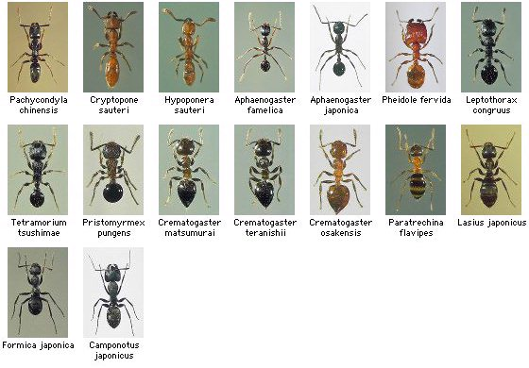
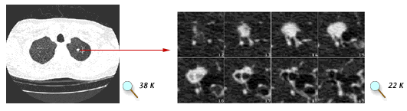
Pattern Recognition & Content Representation
Strong relation
The higher the discriminative capability of a representation exists, the higher the performance of recognition is achieved
Challenges in finding good discriminative features
due to overlapping
irradiance ranges
composition of radiances (content structure, patterns)
How can I find my imject among these?

Slide 20

Pattern
Pattern: a signal whose elements have some common contextual characteristics
A contextual characteristic for patterns in images can be based on
a geometric (such as distance, shape),
a topological,
a feature of domain of interest (such as photometric features)
An imject (image object) can be defined by means of patterns:
Co-occurrence of some gray levels
0 | 0 | 1 | 2
1 | 1 | 2 | 4
1 | 1 | 2 | 4
2 | 2 | 3 | 5

Slide 21

Pattern Recognition
making a decision about class of an object by assigning its class to a known population [Looney97]
Generalization is one of the goal/aspects of a pattern recognition task [Bish06]
Learning approach
Supervised
assign a pattern to a predefined class
Unsupervised
group patterns according to a similarity metric

Slide 22
How does the Machine accomplish the detection?
How does the Machine use image content for the object detection?
How does the Machine use patterns for the imject detection?
Image Content
Pattern recognition
IMJECT recognition
MACHINE INTELLIGENCE

Slide 23
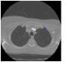
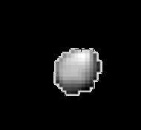
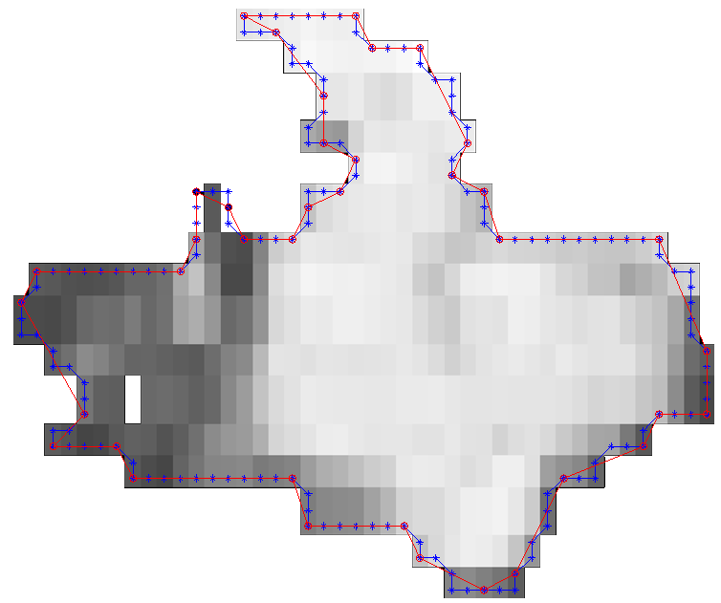

… Closing the story
The Machine computes patterns of the imject
Slice
ROI
Mask
0 | 0 | 1 | 2
1 | 1 | 2 | 4
1 | 1 | 2 | 4
2 | 2 | 3 | 5
Shape pattern
{(x1, y1), (x2, y2), .. }
computes feature vector representation
Color pattern

Slide 24
Decision Engine
Feature Extraction
Feature Set Preparation
Decision Engine

Slide 25
The ISIP conceptual model structure
Ömer M. Soysal, Jianhua Chen, Steven Bujenovic, Helmut Schneider (2010). "A Hierarchical Decision Engine for Computer Aided Lung Nodule Detection from CT Images", 11th International Conference on Bioinformatics and Computational Biology (BIOCOMP'10) in WORLDCOMP’10, vol1, pp.387-393.

Slide 26
..ASSESMENT
Figure 3 Average change of classification performance through Decision Engine Layers

Slide 27
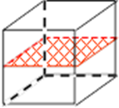
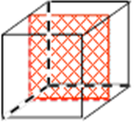
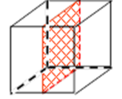
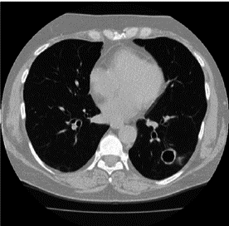
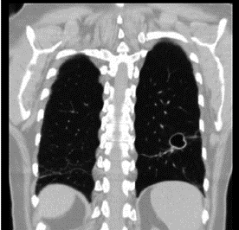
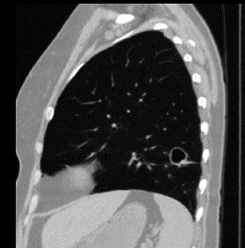
Multi-Perspective Hierarchical Deep-Fusion Learning Model
MS₁
MP₁
Transverse Plane
Coronal Plane
Sagittal Plane
V₁
Nodule
Non-nodule
VOI
MS₂
MP₂
MV
V₂
MS₃
MP₃
V₃
K Sekeroglu, OM Soysal, X Li. “Hierarchical Deep-Fusion Learning Framework for Lung Nodule Classification”, International Conference on Machine Learning and Data Mining (MLDM) 2, pp:792-894.

Slide 28
Fusion of the class scores obtained from MS module
MS₁
MP₁
MS₂
MP₂
MV
MS₃
MP₃
There are k slices in each perspective of each nodule
Perspective Module (MPi)
0.5
0.8
0.4
.
.
.
0.6
Hidden layer
Generated Input
Output layer
Input layer
MS_{i}
Transpose
0.5, 0.8, 0.4, . . . , 0.6
Transformed to a feature vector

Slide 29
Slices from
XY-Perspective for
single 3D object
0.5
0.8
0.4
.
..
0.6
XY- Perspective level prediction
MP₁
0.7
MS₁
Transposed
0.5, 0.8, 0.4,.., 0.6
Slice level class scores Transformed to a feature vector
Slices from
XZ-Perspective for
single 3D object
Volume level fusion of multiple perspectives
0.3
0.7
0.6
.
..
0.9
XZ - Perspective level prediction
MP₂
0.7
0.8
0.7
MV
0.8
0.9
Final Score
MS₂
Transposed
0.3, 0.7, 0.6,.., 0.9
Slice level class scores Transformed to a feature vector
Slices from
YZ-Perspective for
single 3D object
0.7
0.5
0.8
.
..
0.7
YZ - Perspective level prediction
MP₃
0.7
MS₃
Transposed
0.7, 0.5, 0.8,.., 0.7
Slice level class scores Transformed to a feature vector

Slide 30
Slice module (MS) is a DCNN
MPF Model
MS₁
MP₁
MS₂
MP₂
MV
Slice Module (MS)
MS₃
MP₃
FC Layer
Input image
Convolution
Convolution
Pooling
Convolution
FC Layer
Pooling
Convolution
Pooling
Pooling
Output Layer
56x56
56x56
28x28
28x28
14x14
12x12
Non-Nodule
Nodule
6x6
4x4
2x2
2x1
32
64
64
16
32
32x1
8
16
8
256x1

Slide 31
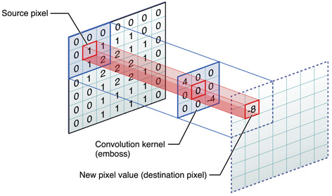
Slice Module (MS)
FC Layer
Input image
Convolution
Convolution
Pooling
Convolution
FC Layer
Pooling
Convolution
Pooling
Pooling
Output Layer
56x56
56x56
28x28
28x28
14x14
12x12
Non-Nodule
Nodule
6x6
4x4
2x2
2x1
32
64
64
16
32
32x1
8
16
8
256x1
Max Pooling
Convolution
[https://developer.apple.com]

Slide 32
Perspective Modules (MP)
MS₁
MP₁
MP₁
Hidden layer
MS₂
MP₂
MV
Output layer
MS₃
MP₃
MP₂
Volume Module (MV)
Hidden layer
Hidden layer
Nodule
Non-nodule
Output layer
Input layer
Output layer
MP₃
Hidden layer
Output layer

Slide 33
Data Collection
The largest publicly available lung CT scan database created by The Lung Image Database Consortium (LIDC) and Image Database Resource Initiative (IDRI) is used.
The annotation of the CT scans were done by 4 expert radiologists in 2 phases, blinded-read phase and unblinded-read phase.
Annotations made by the radiologists belong to one of these three groups; nodule≥3mm, nodule≤3mm, or non-nodule≥3mm.

Slide 34
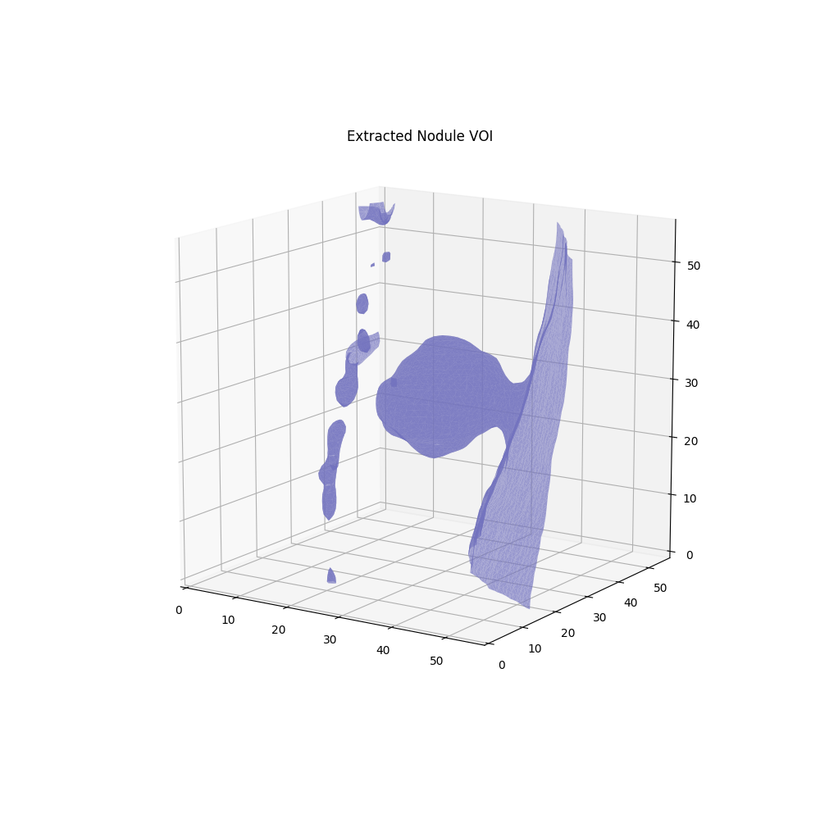
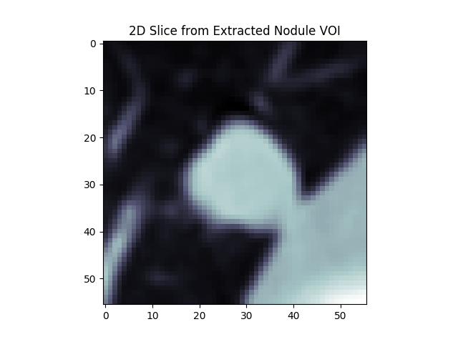
...Data Collection
100 CT scans are used from LIDC/IDRI dataset
Total of 604 nodule and non-nodules are used.

Slide 35
Experimental Results
Change of slice level classification performances across different perspectives

Slide 36
...Experimental Results
Change of perspective level classification performances across different perspectives

Slide 37
...Experimental Results
Change of classification performance for slice, perspective and volume level classifications for each perspective

Slide 38
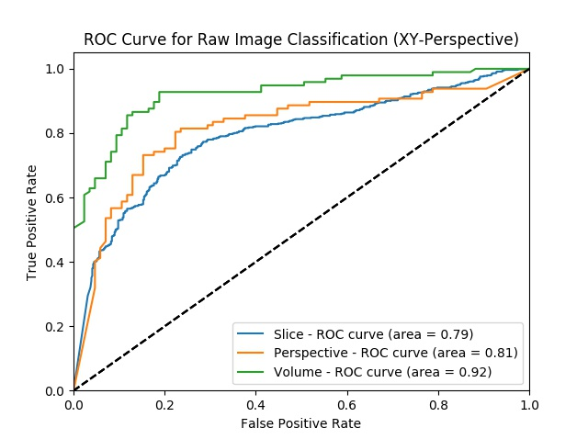
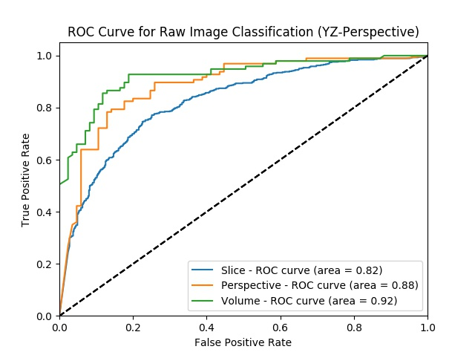
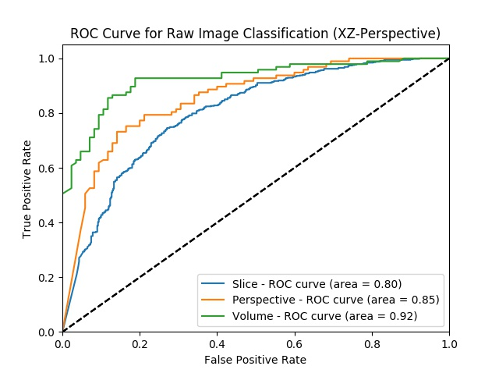
ROC curve for
XZ perprective
ROC curve for
XY perprective
ROC curve for
YZ perprective

Slide 39
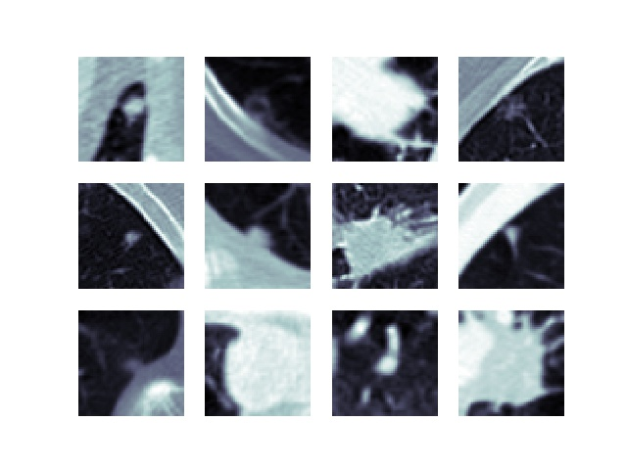
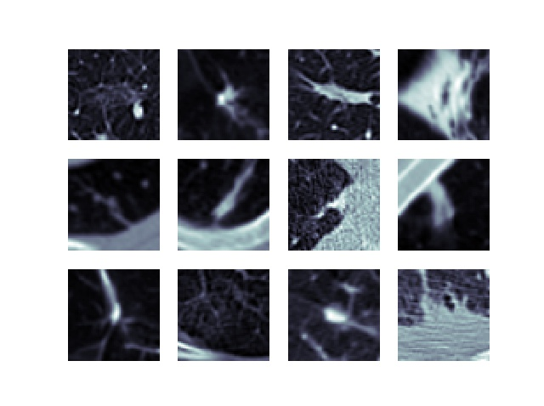
...Experimental Results
Missed nodules (FN) by the proposed model
Missed non-nodules (FP) by the proposed model

